Slide 1
ReGAL: Rule-guided Active Learning for Deep Text Classification
David Kartchner, Wendi Ren, Davi Nakajima An, Chao Zhang, Cassie Mitchell

Slide 2
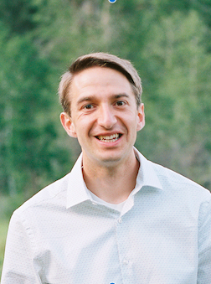
About Me
3rd-year PhD student working with Cassie Mitchell in BME
I research NLP for biomedical applications, including drug discovery, disease etiology, and scientific information extraction.
I have worked as an AI/ML engineer for Intermountain Healthcare, GSK, and Recursion Pharmaceuticals.
I enjoy reading, running, frisbee, and spending time with my wife and toddler.

Slide 3
Roadmap
Problem and motivation
Introduction to weakly supervised learning
ReGAL: Rule-guided Active Learning

Slide 4
Motivation: Getting labeled data is hard
Time
Expertise
Cost
Privacy

Slide 5
GLUE vs. BLUE
 | GLUE | BLUE
Domain | General | Biomedical
Datasets | 9 | 10
Tasks | 9 | 5
Mean train size | 105,704 | 3,729

Slide 6
Labeling Needs
Efficient use of expert time
Maximal number and informativeness of labels
Model transparency
This Photo by Unknown Author is licensed under CC BY

Slide 7
Image source: https://dawn.cs.stanford.edu/2017/07/16/weak-supervision/

Slide 8
Image source: https://dawn.cs.stanford.edu/2017/07/16/weak-supervision/

Slide 9
Transfer learning
Most common approach
Examples:
BioBERT
BLUEBERT
ClinicalBERT
PubMedBERT
SciBERT
Does nothing to create labels for new tasks

Slide 10
Image source: https://dawn.cs.stanford.edu/2017/07/16/weak-supervision/

Slide 11
Active Learning
Create a maximally informative subset of high-quality examples
Greedily pick example that will offer most feedback to model
Query strategies:
Model uncertainty
Representativeness (e.g. of data clusters)
Expected parameter change
Diversity
Use cases
NLP for low-resource domains
Quick data annotation (Prodigy, Tagtog, Labelbox)
Weaknesses:
Small data size
High setup cost

Slide 12
Image source: https://dawn.cs.stanford.edu/2017/07/16/weak-supervision/

Slide 13
Weak Supervision
Create noisy labels with labeling rules
Databases/distant supervision
Keywords/patterns
Heuristics
Let a model sift signal from the noise
Weaknesses
Label noise
Label imbalance
Label Incompleteness in tail
Writing good labeling functions is hard

Slide 14
So… Where do labeling functions come from?
Experts
Databases

Slide 15
Weak supervision examples
Image source: http://ai.stanford.edu/blog/weak-supervision/

Slide 16
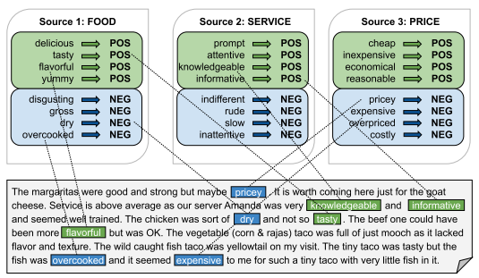
Covering all cases can be hard
Long tail of examples
“As candidate rules, we manually review the set of all phrases occurring between two entities in our corpus that occur more than k times…”
Excessive effort writing rules misses the point
Image source: Ren et al., 2020. “Denoising Multi-Source Weak Supervision for Neural Text Classification”

Slide 17
Solution: Active learning on labeling functions (LFs) to learn optimal weak supervision

Slide 18
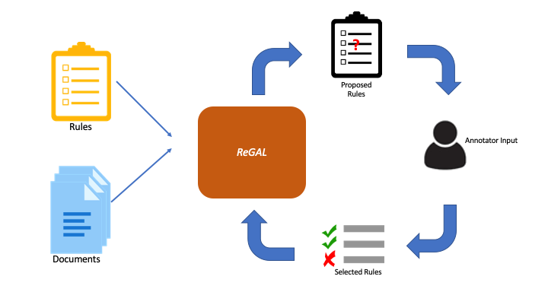
ReGAL
Framework to perform active learning on rules rather than instances
Model learns to create labeling functions, which are then accepted/rejected by a user

Slide 19
Model Architecture

Slide 20
How ReGAL works by example
Sentence: ”The food was good, but the service was rude and slow.”
Label: Negative
Rules:
HAS(“good”) -> Positive
HAS(”tasty”) -> Positive
HAS(“slow”) -> Negative
HAS(“dirty”) -> Negative

Slide 21
ReGAL – Encoding Input

Slide 22
ReGAL – Encoding Input

Slide 23
ReGAL – Encoding Input

Slide 24
ReGAL – Encoding Input

Slide 25
ReGAL – Encoding Input

Slide 26
ReGAL – Encoding Input

Slide 27
ReGAL – Denoising Rules

Slide 28
ReGAL – Denoising Rules

Slide 29
ReGAL – Denoising Rules

Slide 30
ReGAL – Proposing Rules

Slide 31
ReGAL – Proposing Rules
$$\frac{1}{{\left|v_{j}\right|}^{γ}}\sum_{d_{i}∈D}{{\sum_{v_{j}∈d_{i}}{a_{ij}}p}_{i}}$$

Slide 32
ReGAL – Proposing Rules
$$\frac{1}{{\left|v_{j}\right|}^{γ}}\sum_{d_{i}∈D}{{\sum_{v_{j}∈d_{i}}{a_{ij}}p}_{i}}$$
$γ$ tunes the balance between accuracy and coverage

Slide 33
ReGAL example

Slide 34
Human Considerations
Show examples of training instances matched by rule

Slide 35
Experiments
Datasets:
Yelp
IMDB
Baselines
Majority vote of labeling functions
BERT (trained with majority class labels)
MSWS (Ren et al., 2020)

Slide 36
Seed Rules

Slide 37
Generated Rules -- IMDB

Slide 38
Generated Rules -- Yelp

Slide 39
Model Performance

Slide 40
Why do we care?
We can teach models to iteratively generate high-quality labeling rules
This could quickly improve coverage/performance on poor-performing data slices
Generate labels on potentially thousands of instances with each expert solicitation

Slide 41
Future work
Generate higher-complexity rules
Focus model on low-performing data slices
Human experiments and design optimization

Slide 42
Interesting related work
Ren et al. “Denoising Multi-Source Weak Supervision for Neural Text Classification.” Findings of EMNLP (2020).
Awasthi et al. “Learning from rules generalizing labeled exemplars.” ICLR (2020).
Chen et al. “Train and You’ll Miss It: Interactive Model Iteration with Weak Supervision and Pre-trained Embeddings.” Arxiv, 2020.
Zhou at el. “NERO: A Neural Rule Grounding Framework for Label Efficient Relation Extraction.” WWW (2020).

Slide 43
Questions?

